Slide 1
Tutorial 08
Enhancing a Website with Multimedia

Slide 2
Objectives
Understand audio and video formats
Insert an HTML audio clip
Support multiple audio formats
Insert an HTML video clip
Write a video caption track

Slide 3
Objectives (continued)
Format video captions
Create a CSS transition
Explore transition attributes
Create a CSS key frame animation
Apply a CSS animation

Slide 4
Introducing Multimedia on the Web
HTML was the perfect tool to share text and data
The next major phase in HTML language was the introduction of multimedia support
Streaming audio, video, and interactive games, made the web a dominant entertainment platform
One of the biggest challenges
  Delivering multimedia content in a form that can be retrieved quickly and easily without loss of quality

Slide 5
Understanding Codecs and Containers
Codec: Computer program that encodes and decodes streams of data
Codecs compress data to transmit it in fast and efficient manner
Codecs decompress data when it is to be read or played back
The compression method can be either lossy or lossless

Slide 6
Understanding Codecs and Containers (continued 1)
Lossy compression: Nonessential data is removed in order to achieve a smaller file size
Example:
  An audio file might be compressed by removing sounds that the human ear can barely hear
The more the file is compressed, the more the content is lost
Data removed during compression cannot be recovered

Slide 7
Understanding Codecs and Containers (continued 2)
Lossless compression: Data is compressed by removing redundant information
Example:
  AAAABBBBBCCCCCC requires 15 characters of information, which can be rewritten using 6 characters as 4A5B6C
Lossless compression cannot achieve the same level of compression as with lossy compression

Slide 8
Understanding Codecs and Containers (continued 3)
Most codecs involve some combination of lossy and lossless techniques
Codecs are placed within a container that handles the packaging, transportation and presentation of data
Container is the file format identified by a file extension

Slide 9
Understanding Codecs and Containers (continued 4)
The web supports a multitude of container and codec combinations
Not all containers and codecs are equally supported
Example
  Google Chrome uses the WebM container for video content, compressing that data with the VP8 codec; however, that combination of container and codec is not supported by any Apple device

Slide 10
Understanding Plug-Ins
Media player: Decodes and plays multimedia content stored within a container file
Plug-in: Software program accessed by a browser to provide a feature or capability not native to the browser
A plug-in either opens in its own external window or runs within the web page as an embedded object

Slide 11
Understanding Plug-Ins (continued 1)
Problems with the plug-in approach for delivery of multimedia content
  Plugs-ins require users to install a separate application in addition to their web browsers
  A common plug-in is not available across all browsers, operating systems, and devices
  HTML documents that support multiple plug-ins are difficult to create and maintain

Slide 12
Understanding Plug-Ins (continued 2)
Problems with the plug-in approach (continued)
  Plug-ins consume valuable system resources, resulting in slow and unreliable performance
  Plug-ins are a security risk with some of the most prominent Internet attacks working their way into browsers via a plug-in

Slide 13
Working with the audio Element
Audio clips are embedded within a web page using audio element
<audio src=“url” attributes />
where url specifies the source of the audio file and attributes define how the audio clip should be handled by the browser

Slide 14
Working with the audio Element (continued)
Attribute | Description
autoplay | Starts playing the media clip as soon as it is loaded by the browser
controls | Displays the player controls in the web page
loop | Automatically restarts the media clip when it is finished playing
muted | Specifies that the audio output should be muted
preload=”auto|metadata|none” | Specifies whether the media clip should be preloaded by the browser, where auto preloads the entire clip, metadata preloads descriptive data about the clip, and none preloads nothing. metadata (to preload only descriptive data about the clip), or none (not to preload the media clip)
src=”url” | Specifies the source of the media clip, where url is the location and name of the media file

Slide 15
Browsers and Audio Formats
HTML does not specify any particular audio format
  Developers can pick a format that meets the needs of their customers and clients
Browsers and devices differ on the types of audio formats they support
  Before choosing an audio format, determine whether the intended browser will be able to play it

Slide 16
Browsers and Audio Formats (continued 1)
Format | Description | Codec | File Extension(s) | MIME Type
MP3 | MPEG-1 Audio Layer 3 or MP3 is one of the most widely used audio types and is the standard format for digital audio players | MP3 | .mp3 | audio/mpeg
AAC | Advanced Audio Coding or AAC is the encoding standard for all Apple products, as well as YouTube and several gaming systems and mobile devices; AAC was introduced as the successor to MP3 with the goal of achieving better sound quality at similar compression ratios | AAC | .aac .mp4 .m4a | audio/mp4

Slide 17
Browsers and Audio Formats (continued 2)
Format | Description | Codec | File Extension(s) | MIME Type
OGG | A file compression format designed for web audio, Ogg is an open-source and royalty-free format; in general, Ogg provides better sound quality than MP3, especially at lower bit rates | Vorbis | .ogg | audio/ogg
WAV | The original audio format for Windows PCs, WAV is commonly used for storing uncompressed audio, making it impractical for all but the shortest audio clips | PCM | .wav | audio/wav

Slide 18
Browsers and Audio Formats (continued 3)
Format | Description | Codec | File Extension(s) | MIME Type
FLAC | Free Lossless Audio Codec or FLAC is a free open-source digital music format that offers bit-perfect copies of CD-quality music at half the size | FLAC | .flac | audio/flac
WebM | WebM is an open-source format introduced by Google to provide royalty-free audio and video to be used with the HTML audio and video elements | VP8 VP9 | .webm | audio/webm

Slide 19
Browsers and Audio Formats (continued 4)
Browser | MP3 | AAC | Ogg | WAV | FLAC | WebM
Chrome
Firefox
Microsoft Edge
Opera
Safari

Slide 20
Browsers and Audio Formats (continued 5)
Nest several source elements within a single audio element to provide several versions of the same media file
  <audio>
  <source src=“url1” type=“mime-type” />
  <source src=“url2” type=“mime-type” />
  … </audio>
  where, url1, url2,… are the URLs for each audio file and mime-type specifies the audio format associated with each file

Slide 21
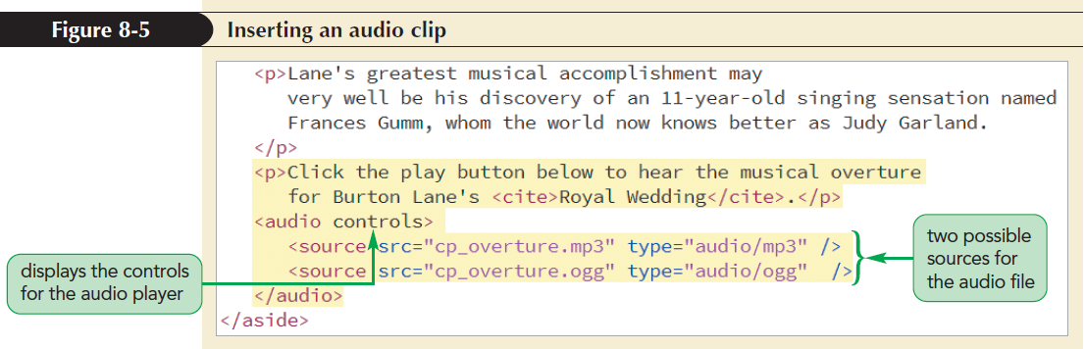
Browsers and Audio Formats (continued 6)

Slide 22
Applying Styles to the Media Player
The appearance of a media player is determined by the browser itself
CSS can be applied to set the width of the media player, add borders and drop shadows, and apply filters and transformations to the player’s appearance

Slide 23
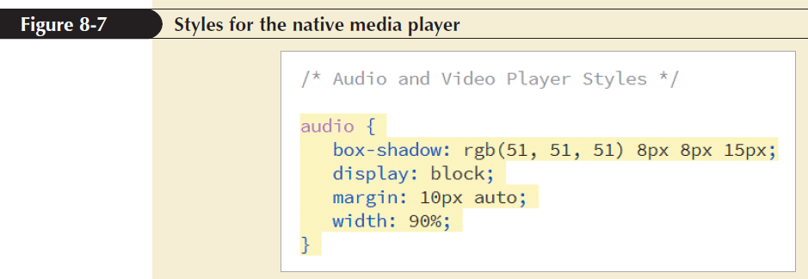
Applying Styles to the Media Player (continued)

Slide 24
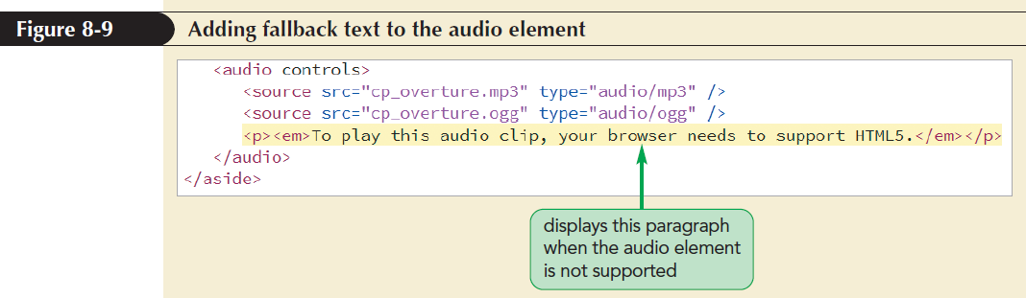
Providing a Fallback to an Audio Clip

Slide 25
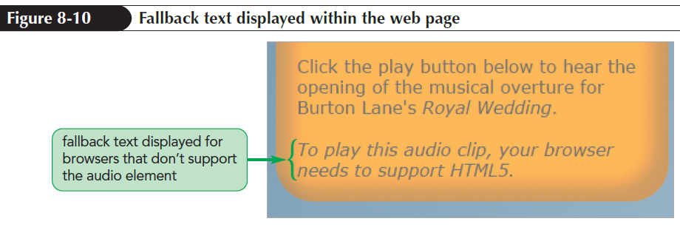
Providing a Fallback to an Audio Clip (continued)

Slide 26
Exploring Embedded Objects
Plug-ins in older browsers are marked using the embed element
  <embed src=“url” type=“mime-type”
  width=“value” height=“value” />
where url is the location of the media file, type attribute provides the mime-type, and width and height attributes set the width and height of the media player

Slide 27
Plug-In Attributes
The src, type, height, and width attributes are generic attributes applied to embed element for any plug-in
The following embed element adds attributes that are recognized by Apple’s QuickTime Player to display the media player controls and prevent the playback from starting automatically:
  <embed src=“cp_overture.mp3” width=“250” height=“50” controller=“yes” autoplay=”no” />

Slide 28
Plug-Ins as Fallback Options
Add the embed element to the end of the audio element as the last option for a browser that does not support HTML5 multimedia elements
Use of plug-ins has steadily declined since the widespread adoption of HTML5 standard

Slide 29
Video Formats and Codecs
A video file contains codecs for the following:
  Audio
  Video images
The most popular video codec is H.264 used by YouTube and most commercial vendors
Because H.264 is a commercial product, it is not royalty free

Slide 30
Video Formats and Codecs
(continued 1)
Codec | Description
H.264 | Developed by the MPEG group, the H.264 codec is the industry standard for high-definition video streams, movie sharing websites such as YouTube, and video plug-ins
Theora | Theora is a royalty-free codec developed by the Xiph.org Foundation that produces video streams that can be used with almost any container
VP8 | VP8 is an open-source royalty-free codec owned by Google for use in Google’s WebM video format
VP9 | VP9 is Google’s successor to the VP8 codec, offering the same video quality as VP8 at half the download size

Slide 31
Video Formats and Codecs
(continued 2)
Format | Description | Video Codec | File Extension(s) | MIME Type
MPEG-4 | MPEG-4 or MP4 is a widely used proprietary format developed by Apple based on the Apple QuickTime movie format | H.264 | .mp4 .m4v | video/mp4
Ogg | Ogg is an open-source format developed by the Xiph.org Foundation using the Theora codec as an alternative to the MPEG-4 codec | Theora | .ogg | video/ogg
WebM | WebM is an open-source format introduced by Google to provide royalty-free video and audio to be used with the HTML5 video element | VP8 VP9 | .webm | video/webm

Slide 32
Video Formats and Codecs
(continued 3)
Browser | MPEG-4 | Ogg | WebM
Chrome
Firefox
Microsoft Edge
Opera
Safari

Slide 33
Using the HTML5 video Element
Videos are embedded into a web page using video element
  <video attributes>
  <source src=“url1” type=“mime-type” />
  <source src=“url2” type=“mime-type” />
  … </video>
where attributes are HTML attributes that control the behaviour and appearance of the video playback, url1, url2,… are the possible sources of the video, and mime-type specifies the format associated with each video file

Slide 34
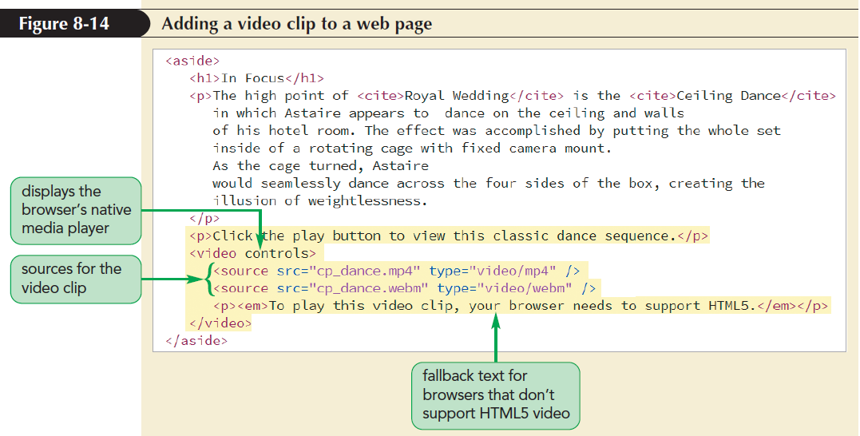
Using the HTML5 video Element (continued 1)

Slide 35
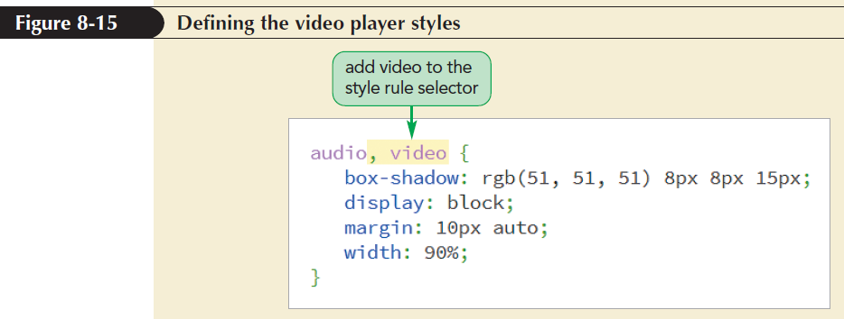
Using the HTML5 video Element (continued 2)

Slide 36
Using the HTML5 video Element (continued 4)
The poster attribute defines a video’s preview image
<video poster=”url”>
…
</video>
where url points to an image file containing the preview image
The poster attribute is used as a placeholder image that is displayed when a video is being downloaded

Slide 37
Adding a Text Track to Video
A text track that needs to be read or recited to visually impaired users can be added to a media clip
Allows audio and video content to be accessible to all users
Text tracks are added to an audio or video clip using track element

Slide 38
Adding a Text Track to Video (continued 1)
<track kind=“type” src=“url” label=“text” srclang=“lang” />
where,
    the kind attribute defines the track type
    the src attribute references a file containing the track text
    the label attribute gives the track name
    the srclang attribute indicates the language of the track

Slide 39
Adding a Text Track to Video (continued 2)
Kind Value | Description
captions | Brief text descriptions synced to specified time points within the media clip; designed for hearing impaired users
chapters | Chapter titles used by the media player to navigate the user to specific time points within the media clip
descriptions | Longer descriptions synced to specified time points within the media clip; designed for visually impaired users
subtitles | (the default) Translation of dialog from the media clip; the language of the subtitle must be specified in the srclang attribute
metadata | Metadata content used by external scripts accessing the media file

Slide 40
Making Tracks with WebVTT
Tracks are stored as simple text files written in Web Video Text Tracks or WebVTT language
Format of a WebVTT file
  WEBVTT
  cue1
  cue2
  …
  where cue1, cue2,… are cues matched with specific time intervals within a media clip

Slide 41
Making Tracks with WebVTT (continued 1)
List of cues is separated by a single blank line after a cue text
White space is not ignored in WebVTT files
General form of a cue
  label
  start --> stop
  cue text
where label is the name assigned to the cue, start and stop define the time interval, and cue text is the text of the cue

Slide 42
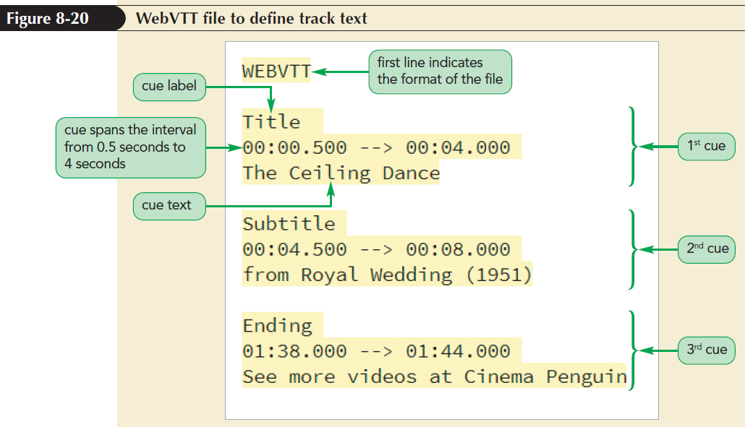
Making Tracks with WebVTT (continued 2)

Slide 43
Placing the Cue Text
Size and position of a cue text can be set using cue settings directly after the cue’s time interval
  setting1:value1 setting2:value2 …
  where setting1, setting2, … define the size and position of the cue text and value1, value2, … are the setting values
There is no space between the setting name and value

Slide 44
Placing the Cue Text
(continued 1)
Cue Setting | Description
align:value | Sets the horizontal alignment of the text within the cue, where value is start (left-aligned), middle (center-aligned), or end (right-aligned)
line:value | Sets the vertical position of the cue within the video window, where value ranges from 0% (top) to 100% (bottom)
position:value | Sets the horizontal position of the cue within the video window, where value ranges from 0% (left) to 100% (right)
size:value | Sets the width of the cue as a percentage of the width of the video window
vertical:type | Displays the cue text vertically rather than horizontally where type is rl (writing direction is right to left) or lr (writing direction is left to right)

Slide 45
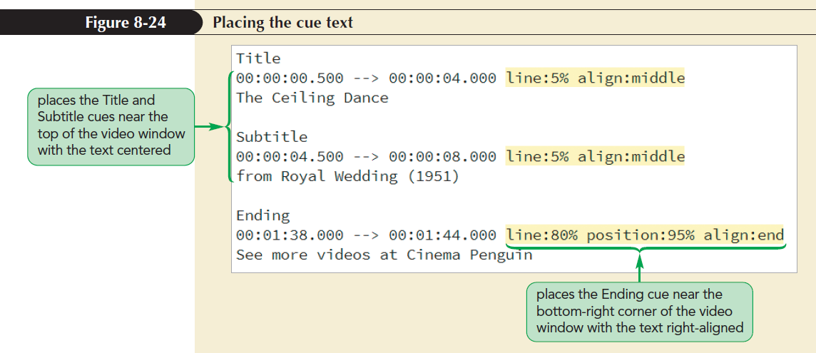
Placing the Cue Text
(continued 2)

Slide 46
Applying Styles to Track Cues
cue pseudo-element to format the appearance of the cues appearing within a media clip
  ::cue {
  styles
  }
Styles for the cue pseudo-element are limited to background, color, font, opacity, outline, text-decoration, text-shadow, visibility, and white-space properties

Slide 47
Applying Styles to Track Cues (continued 1)
Format specific cues or text strings within a cue using the following markup tags:
  <i></i> for italicized text
  <b></b> for bold-faced text
  <u></u> for underlined text
  <span></span> to mark spans of text
  <ruby></ruby> to mark ruby text
  <rt></rt> to mark ruby text

Slide 48
Applying Styles to Track Cues (continued 2)
WebVTT supports tags that are not part of the HTML library
<c></c> tag is used to mark text strings belonging to a particular class
  <c.classname></c>
<v></v> tag is used for captions that distinguish between one voice and another
  <v name></v>

Slide 49
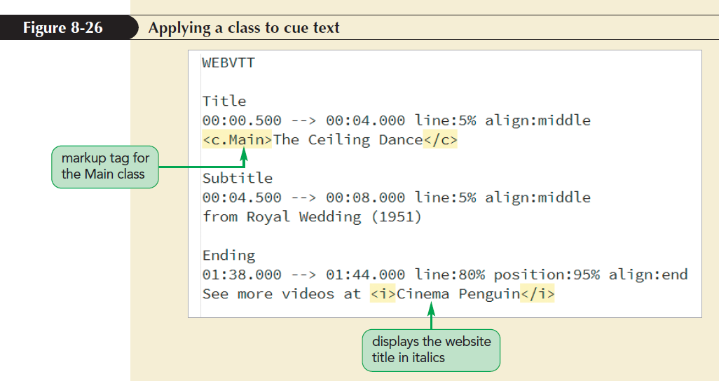
Applying Styles to Track Cues (continued 3)

Slide 50
Using Third-Party Video Players
The object element is used to define browsers with plug-ins
  <object attributes>
  parameters
  </object>
where attributes define the object and parameters are values passed to the object controlling the object’s appearance and actions

Slide 51
Using Third-Party Video Players (continued)
Parameters of the object are defined using param element
  <param name=“name” value=“value” />
where name is the name of the parameter and value is the parameter’s value

Slide 52
Exploring the Flash Player
The most-used plug-in for video playback is Adobe Flash player embedded using the following object element:
  <object data=“url”
  type=“application/x-shockwave-flash”
  width=“value” height=“value”>
  <param name=“movie” value=“url” />
  parameters
  </object>

Slide 53
Exploring the Flash Player
(continued 1)
Name | Value(s) | Description
bgcolor | color value | Sets the background color of the player
flashvar | text | Contains text values that are passed to the player as variables to control the behavior and content of the movie
id | text | Identifies the movie so that it can be referenced
loop | true | false | Plays the movie in a continuous loop
menu | true | false | Displays a popup menu when a user right-clicks the player
name | text | Names the movie so that it can be referenced
play | true | false | Starts the player when the page loads

Slide 54
Exploring the Flash Player
(continued 2)
Name | Value(s) | Description
quality | low | autolow | autohigh | medium | high | best | Sets the playback quality of the movie; low values favor playback speed over display quality; high values favor display quality over playback speed
scale | showall | noborder | exactfit | Defines how the movie clip is scaled within the defined space; a value of showall makes the entire clip visible in the specified area without distortion; a value of noborder scales the movie to fill the specified area without distortion but possibly with some cropping; a value of exactfit makes the entire movie visible in the specified area without trying to preserve the original aspect ratio
wmode | window | opaque | transparent | Sets the appearance of the player against the page background; a value of window causes the movie to play within its own window; a value of opaque hides everything behind the player; a value of transparent allows the page background to show through transparent colors in the player

Slide 55
Embedding Videos from YouTube
YouTube videos are easy to embed in a web page using YouTube’s HTML5 video player
Click the Share button below the YouTube video player to share it
YouTube provides options to post a hypertext link to the video to a multitude of social media sites or to share the link via e-mail

Slide 56
Embedding Videos from YouTube (continued 1)
To embed a video within a website, click Embed, which brings up a preview of the embedded player and the HTML code that needs to be added to the web page
The general code for the embedded player is:
  <iframe width=“value” height=“value” src=“url”
  frameborder=“0” allowfullscreen>
  </iframe>

Slide 57
Embedding Videos from YouTube (continued 2)
where,
    the url provides the link to the YouTube video
    width and height attributes define the dimensions of the player embedded on a web page
    frameborder attribute sets the width of the border around the player in pixels
    allowfullscreen attribute allows the user to play the video in full screen mode

Slide 58
Embedding Videos from YouTube (continued 3)
The iframe element itself is used to mark inline frames
Inline frames
  Windows embedded within a web page that display the content of another page or Internet resource

Slide 59
HTML5 Video Players
HTML5 video player works within a browser with CSS and JavaScript files
It presents a customizable player that can be adapted to the needs of business or organization
For example, YouTube player that provides both the player and a hosting service for the video content

Slide 60
HTML5 Video Players
(continued 1)
HTML5 includes video players
  JWPlayer
    A popular commercial player that supports both HTML 5 and Flash video
  VideoJS
    A free player that works with the popular WordPress HTML framework
  Flowplayer
    Originally marketed as a Flash player, Flowplayer is a commercially licensed audio and video player, payable as a one-time fee for perpetual use

Slide 61
HTML5 Video Players
(continued 2)
HTML5 includes video players (continued)
  Kaltura Player
    A free open-source video player that can be customized with user-created player controls and skins to match the design of one’s website
  Wistia
    An HTML 5 video player focused on business needs and applications

Slide 62
Introducing Transitions
Transition: Change in an object’s style from the initial state to the ending state, usually in response to an event initiated by the user or the browser
It slows down the change from one color to another and provides intermediate styles

Slide 63
Introducing Transitions (continued)
To create transition, employ the following transition style:
  transition: property duration;
where property is a property of the object that changes between the initial and end states and duration is the transition time in seconds or milliseconds

Slide 64
Setting the Transition Timing
Varying speed of transition is defined using
  transition: property duration timing-function;
where timing-function is one of the following keywords:
  ease: (the default) Transition occurs more rapidly at the beginning and slows down near the end
  ease-in: Transition starts slowly and maintains a constant rate until the finish

Slide 65
Setting the Transition Timing (continued 1)
timing-function keywords (continued)
  ease-out: Transition starts at a constant rate and then slows down toward the finish
  ease-in-out: Transition starts slowly, reaches a constant rate, and then slows down toward the finish
  linear: Transition is applied at a constant rate throughout the duration

Slide 66
Setting the Transition Timing (continued 2)
Timing function can be visualized as a graph
It shows the progress of transition vs. duration
The graphical representation of the timing function is the basis of another measure of transition timing using
cubic-bezier(n, n, n, n)
Where the n parameter values define the shape of the timing curve

Slide 67
Delaying a Transition
Transition does not need to start immediately after the event that triggers it
Start of the transition can be delayed by adding delay value to the following:
  transition: property duration timing-function delay;
where delay is measured in seconds or milliseconds

Slide 68
Creating a Hover Transition
The transition property can be added to slow down the transition from initial to end state
Limitations of transition
  It can only be run when a CSS property is being changed, such as during the hover event
  It is run once and cannot be looped for repetition
  Initial and end states of the transition can be defined but not the styles of intermediate states
  Animation is created to overcome the limitations

Slide 69
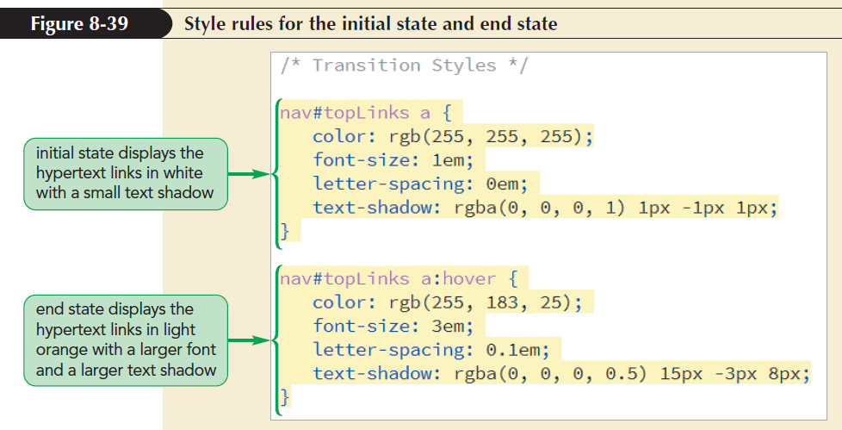
Creating a Hover Transition (continued)

Slide 70
Animating Objects with CSS
Key frame: Sequence of changing images to create illusive movement for animation
CSS replaces the concept of key frame images with key frame styles that are applied in rapid succession to a page object

Slide 71
The @keyframes Rule
To define a sequence of key frames in CSS, apply the following @keyframes rule
@keyframes name {
keyframe1 {styles;}
keyframe2 {styles;}
…}

Slide 72
The @keyframes Rule (continued)
where,
  name provides the name or title of the animated sequence
  keyframe1, keyframe2, and so on defines the progress of individual key frames
  styles are the styles applied within each key frame

Slide 73
Applying an Animation
Key frames animation is applied to an object using animation-name and animation-duration properties
animation-name: keyframes;
animation-duration: times;
where keyframes is a comma-separated list of animations applied to the object using the names from the @keyframes rule and times are the lengths of each animation expressed in seconds or milliseconds

Slide 74
Applying an Animation (continued 1)
Property | Description
animation-name = keyframes | Assigns the keyframes animation to the object
animation-duration = time | Sets the length of the animation in seconds or milliseconds (default = 0s)
animation-timing-function = ease|ease-in|ease-out|ease-in-out|linear|cubic-bezier(n,n,n,n) | Defines the default timing between key frames in the animation (default = ease)
animation-delay = time | Sets the delay time in seconds and milliseconds before animation is started (default = 0s)
animation-iteration-count = value|infinite | Specifies the number of times the animation is played, where value is an integer and infinite repeats the animation without stopping (default = 1)

Slide 75
Applying an Animation (continued 2)
Property | Description
animation-direction = normal|reverse|alternate|alternate-reverse | Defines the direction of the animation, where normal plays the animation as defined in the @keyframes rule, reverse reverses the order, alternate plays the animation in the normal direction followed by the reverse direction (for multiple iterations), and alternate-reverse plays the animation in reverse direction followed by normal direction (default=normal)
animation-fill-mode = none|backwards|forwards|both | Defines what styles from the animation are applied to the object outside the time it is running, where none does not apply any styles, backwards applies the styles from the first key frame, forwards applies the styles from the last key frame, and both applies styles in both directions (default=none)
animation-play-state = running|paused | Defines whether the animation is running or paused (default = running)

Slide 76
Controlling an Animation
Animation can have two states of operation
  Play or pause
Check box can be used to control animation
Selecting the check box will play the animation
Unselecting the check box will pause the animation

Slide 77
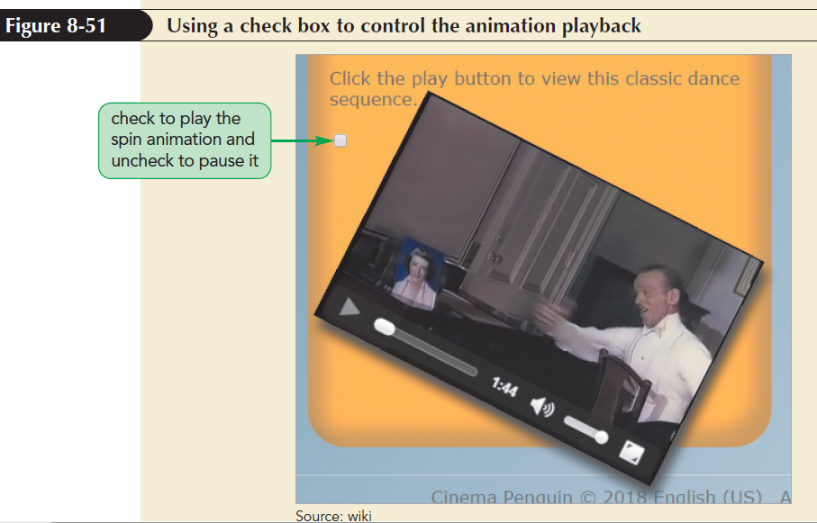
Controlling an Animation
(continued 1)

Slide 78
Controlling an Animation
(continued 2)
Check box can be replaced with more attractive icons
Display symbol  to run the animation
  Unicode value of \21bb
Display symbol  to pause the animation
  Unicode values of \270b

Slide 79
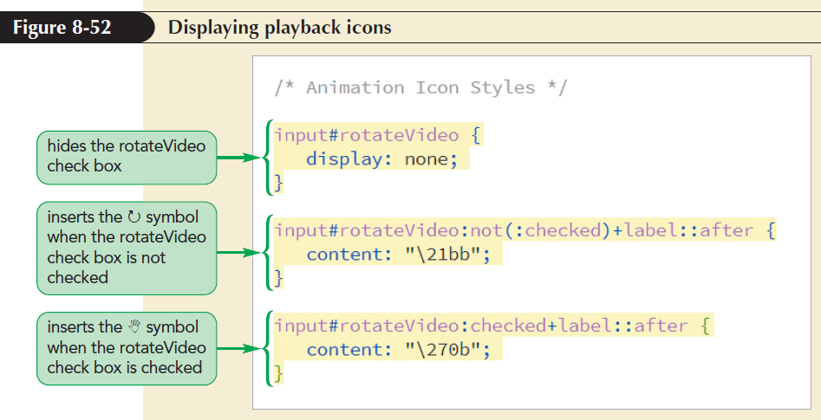
Controlling an Animation
(continued 3)

